Slide 1
Edyoda : Data Wrangling & Visualization
Introduction to Data Wrangling
(21-11-2022)

Slide 2
Index
What is Data Wrangling?
Why all Python Developers need to learn Data Wrangling?
Common Libraries for Data Wrangling - NumPy, Pandas & Seaborn
Comparison with Python List

Slide 3
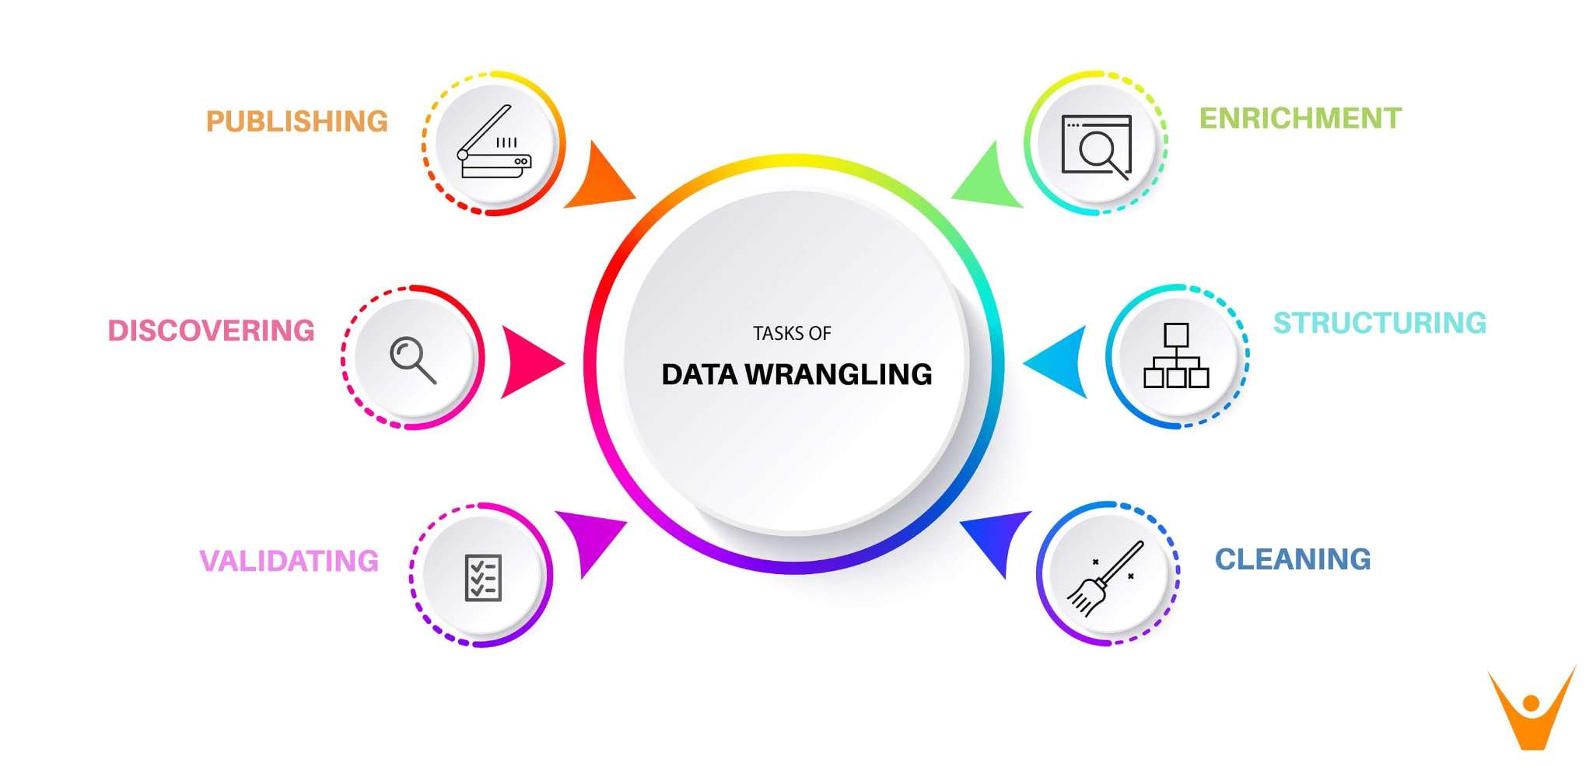
What is Data Wrangling?

Slide 4
2. Why all Python Developers need to learn Data Wrangling?
Solid Foundation
Gather data
Standardization
Readiness for Business Insights
Potential career paths

Slide 5
3. Common Libraries for Data Wrangling
- NumPy - Pandas - Seaborn

Slide 6
4. Comparison with Python List
homogeneous data-types
stored in contiguous memory locations
The NumPy package breaks down a task into multiple fragments and then processes all the fragments parallelly.
The NumPy package integrates C, C++, and Fortran codes in Python. These programming languages have very little execution time compared to Python.
The main benefits of using NumPy arrays are smaller memory consumption and better runtime behavior.
Vectorization : Elimination of for loops

Slide 7
10 Awesome Data Manipulation and Wrangling Hacks, Tips and Tricks link

